Slide 1
Using Bayesian Optimization in Pose Graphs Based SLAM 1st September
Zuxun Wang

Slide 2
Progress Since Last Meeting
Performance check for Linear System
Bayes Opt results for 2Dof Linear system
Performance check for GPS System

Slide 3
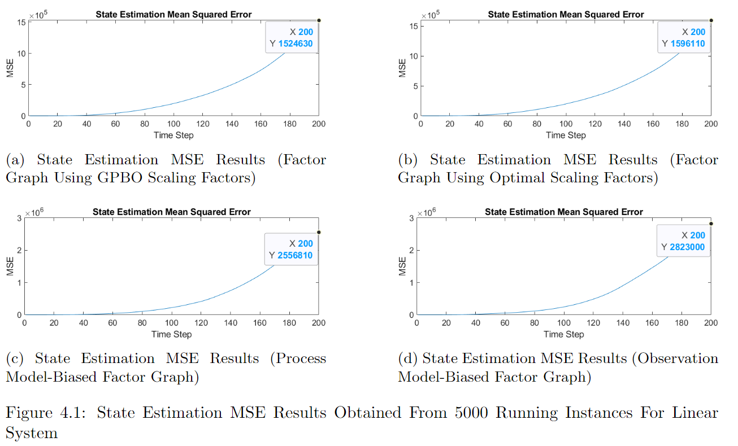

Slide 4
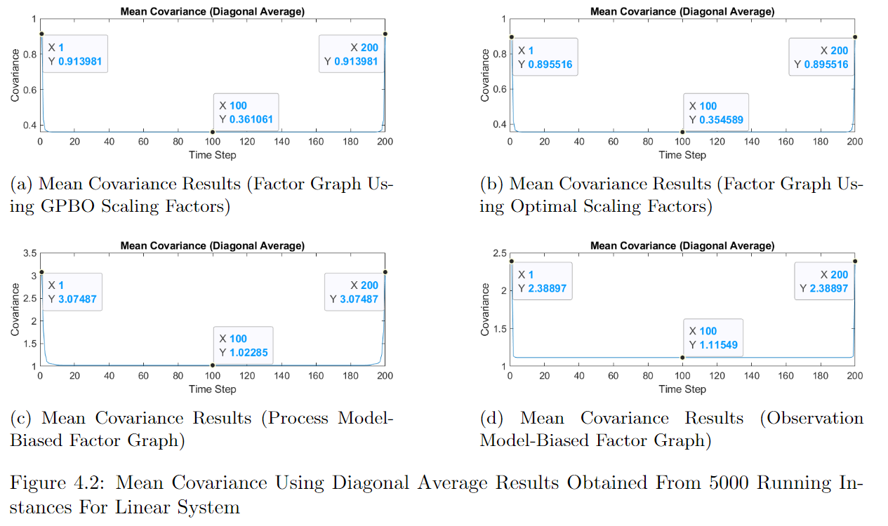

Slide 5
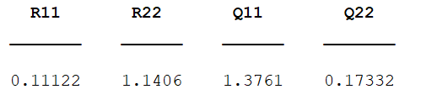
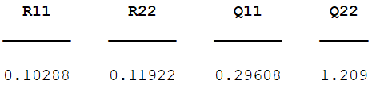
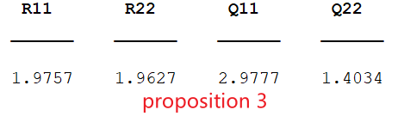
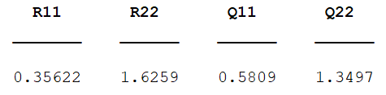
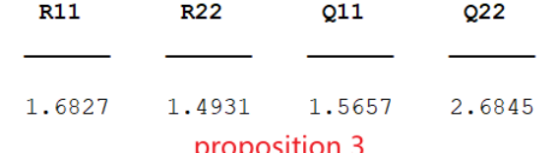
2D Linear System Results (Prop3)
Total number of timestep: 200
Number of episodes: 1000
numObs: 50
obsPeriod: [1 5 10]
Cost function: Sum(C)

Slide 6
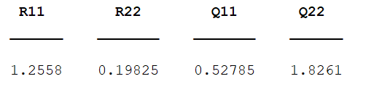
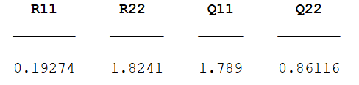
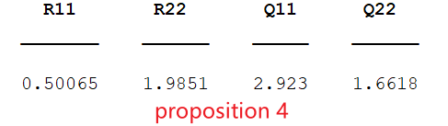
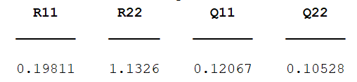
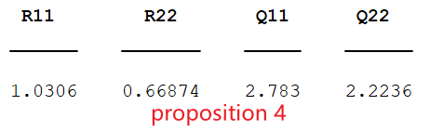
2D Linear System Results (Prop4)
Total number of timestep: 200
Number of episodes: 1000
numObs: 50
obsPeriod: [1 5 10]
Cost function: Sum(C)

Slide 7
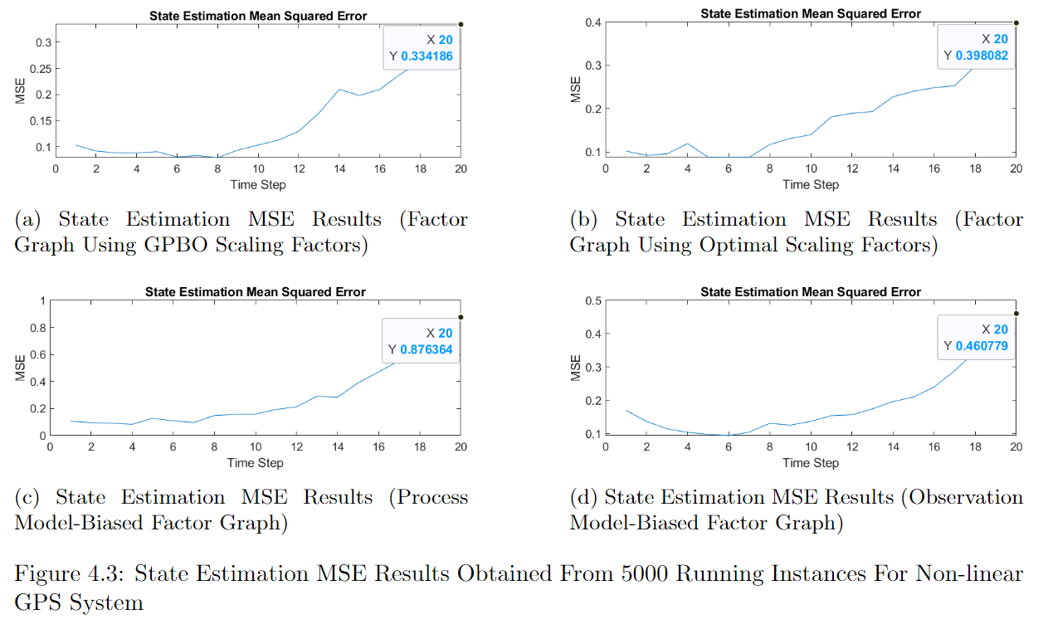

Slide 8
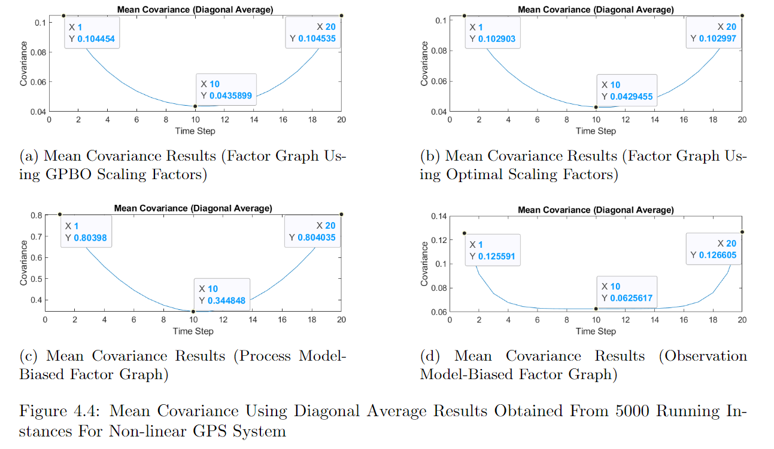

Slide 9
Problems / Issues

Slide 10
Planned Activities

